Slide 1
Muscle Force Estimation for Personalized Musculoskeletal Model
Creation of personalized musculoskeletal Model
Muscle force and activation estimation with external assistive muscle
Chetan Thakur (M155141)
Notes:
- Topic
- 2 SubTopic

Slide 2

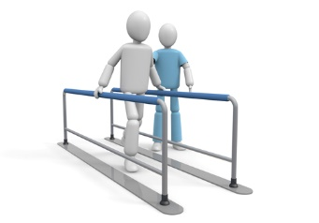
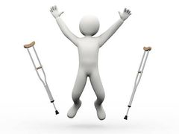

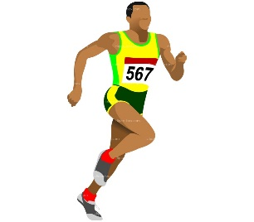

Assistive Muscle
External Assistive Muscle
Application
Advantages
External Source of strength for human
Improves physical capabilities
Active or Passive
Health Care and rehabilitation
Work involved lifting heavy items
Sports
Reduces stress on human muscle
Faster recovery
Reduces muscle fatigue
Improve Performance in sports
Notes:
What is assistive muscle ?
Where do we need it ?
Why do we need it ?
But how to use it ? How do we know that ? => to the next slide

Slide 3

Problem for testing Assistive Muscle
Placement
Effects
Strength Regulation
Ability to see improvement in muscle force generation
Reduced muscle fatigue level
Muscle activation
Changes in DOF
Find out endpoints to increase muscle strength in % (i.e. 10 %, 20% …) of the individual muscle strength
Notes:
Must know how to place it i.e. endpoints
1 Increase strength of the hand
2 Increase strength of the leg muscle
Effects
Changes in the strength
Changes in the muscle activation
Fatigue level
Changes in the DOF after using assistive muscle
Strength Regulation
- Find the endpoints to attach the muscle
record what’s the changes in the strength and activation
This can then be used to analyze and identify muscle endpoint for various strength levels
This in turn can result in to strength regulator

Slide 4
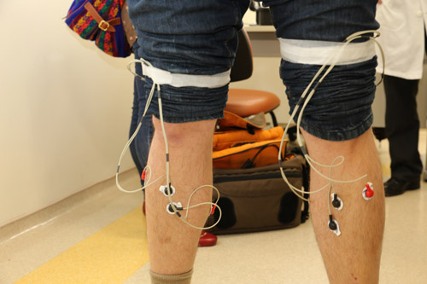
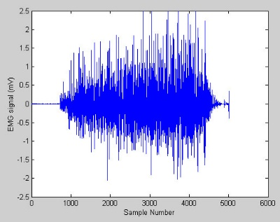
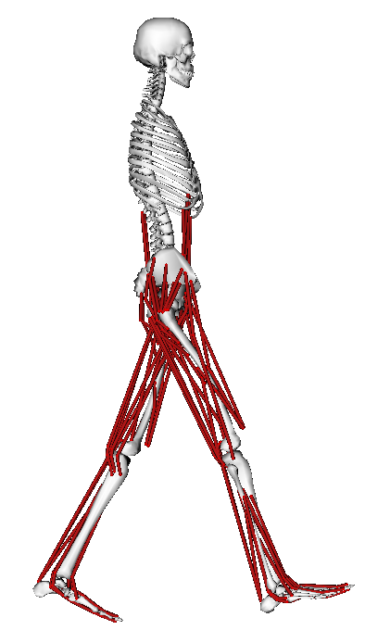
Conventional Methods vs Simulation
Traditional Method to use emg sensor to find muscle strength and fatigue level for muscles in respective motion.
Use OpenSim to simulate model, motion, external force, to test the results of using assistive muscle
Force (N)
Time
Notes:
Conventional method
Use of emg sensors
This should then repeat many times till one finds appropriate endpoints for the assistive muscle
Use opensim for simulation
This makes it easy to analyse and find

Slide 5
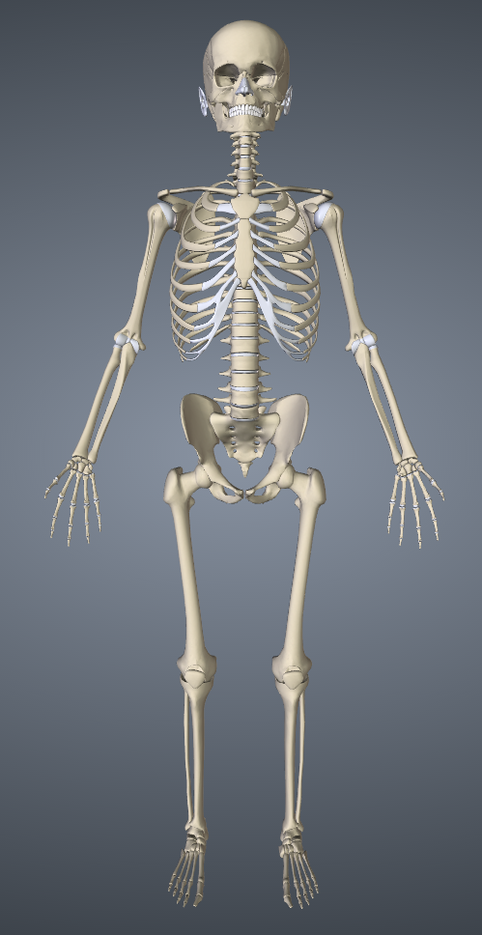

Research Introduction – Simulation
Personalized Musculoskeletal Model
Attach Assistive Muscle
Estimation of Muscle Force and Activation
Force (N)
Time
Build personalized musculoskeletal model
Properties used are
Height
Weight
Bone lengths
Etc…
Simulate adding assistive muscle to personalized model
Reconfigure the model with muscle properties
Online Static optimization for the given motion
Changes are reflected in the online graphs
Data validation
Notes:
Personalized model
Minimum input requires are weight, height bone lengths
This can be user inputs or taken from Kinect skeletal mapping
Attach assistive muscle
Attach assistive muscle to the model just created
Mode reconfigure happens without closing the model . So no need to close the model
Force and Activation Estimation
- Online graphs to see the changes due to assistive muscle

Slide 6
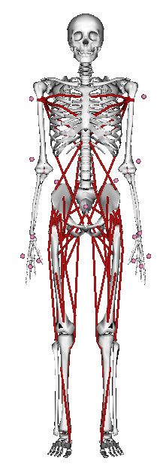
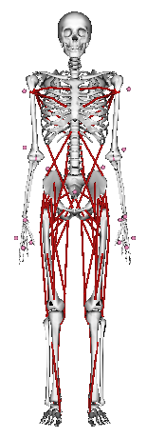
Development Personalized Musculoskeletal Model
Opensim SDK
SimBody API
SimTK API
Create new model customized for individual parameters.
Example:
Fig A and Fig B are model for short and tall human. While creating new model changes in the properties takes place. Such as
Bone lengths
Joint Angles
Center of mass
Muscle length
etc..
Fig A
Fig B
Notes:
What it takes to develop personalized model

Slide 7
Assistive Muscle and Static Optimization
Muscle Force generation without and with assistive muscle
Without Assistive Muscle
With Assistive Muscle
Force (N)
Force (N)
Time
Time
Force (N)
Force (N)
Time
Time
Notes:
Force generation for
sar_r = Sartorius
and
rect_fem_r = rectus femoris

Slide 8
Assistive Muscle and Static Optimization
Muscle activation without and with assistive muscle
Without Assistive Muscle
With Assistive Muscle
Time
Time
Time
Time
Notes:
Muscle activation for sar_r and rect_fem_r

Slide 9
Learnings and Further Research
Learnings:
Opensim to simulate the musculoskeletal model, motion
Static optimization tool for muscle force and activation
OpenSim API
To create musculoskeletal model
Perform static optimization
Update model properties
Etc…
Further Research:
Write tool to simulate real time changes for following action using Opensim/SimTK Infrastrucutre
Build personalized musculoskeletal model
Attach assistive muscle to the model
Show online muscle force generation and activation

